Slide 1




Near Field
Communication
For 6G
Presented by
Pallab Sarkar
Roll-002010801176
JUEE Section B
Measurements & Instrumentation Seminar 2023

Slide 2




Topics for Today
5G to 6G Jump
Revision of 5G Technologies
From Far Field Beem Steering to Beem Focusing
6G Vision , Requirements , Quality Standard
Challenges & Potential

Slide 3


Revision of 5G
Technologies.

Slide 4


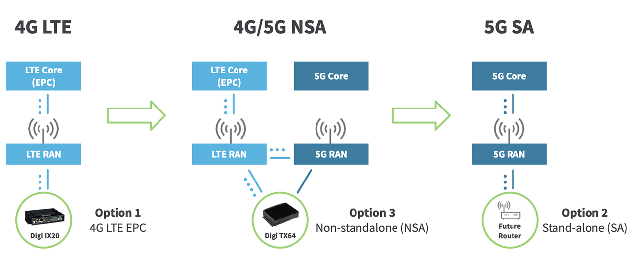
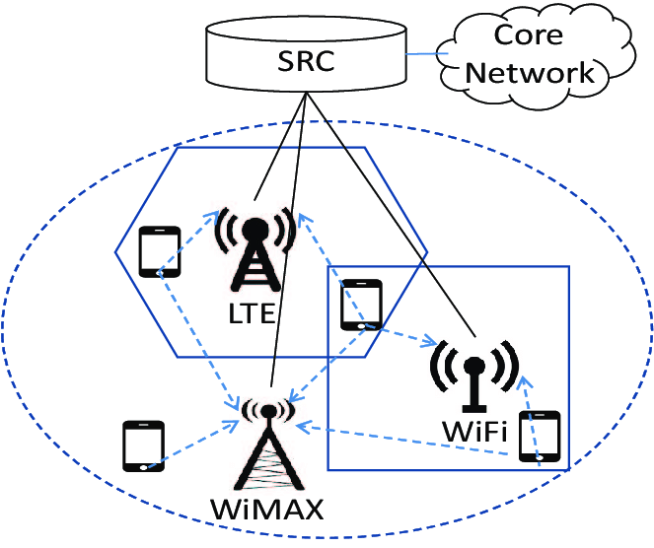
5G
HET NET Distribution Diagram of
3GPP Standard – 5G

Slide 5
5G
5G promises ultra-low latency enabler to shorten processing times and transmission intervals
Physical channel structure and media access control must be built for quick decoding and instant access. Collision hazards must be reduced to meet low latency criterion.
Self-Organising Network (SON) management in 5G is the primary force behind advancements in operation, administration, and management tasks.

Slide 6
5G
5G Enablers
Dynamic Refresh
SON Connectivity
Congruence with Existing LTE for NSA Mode
1:M Slicing

Slide 7
HOW WILL WE COMMUNICATE
IN THE FUTURE?

Slide 8
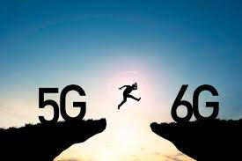

JUMP FROM 5G TO 6G

Slide 9
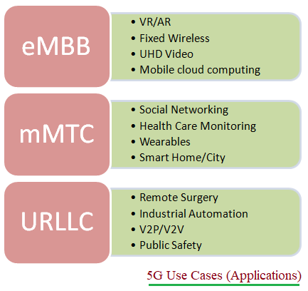

6G enablers

Slide 10
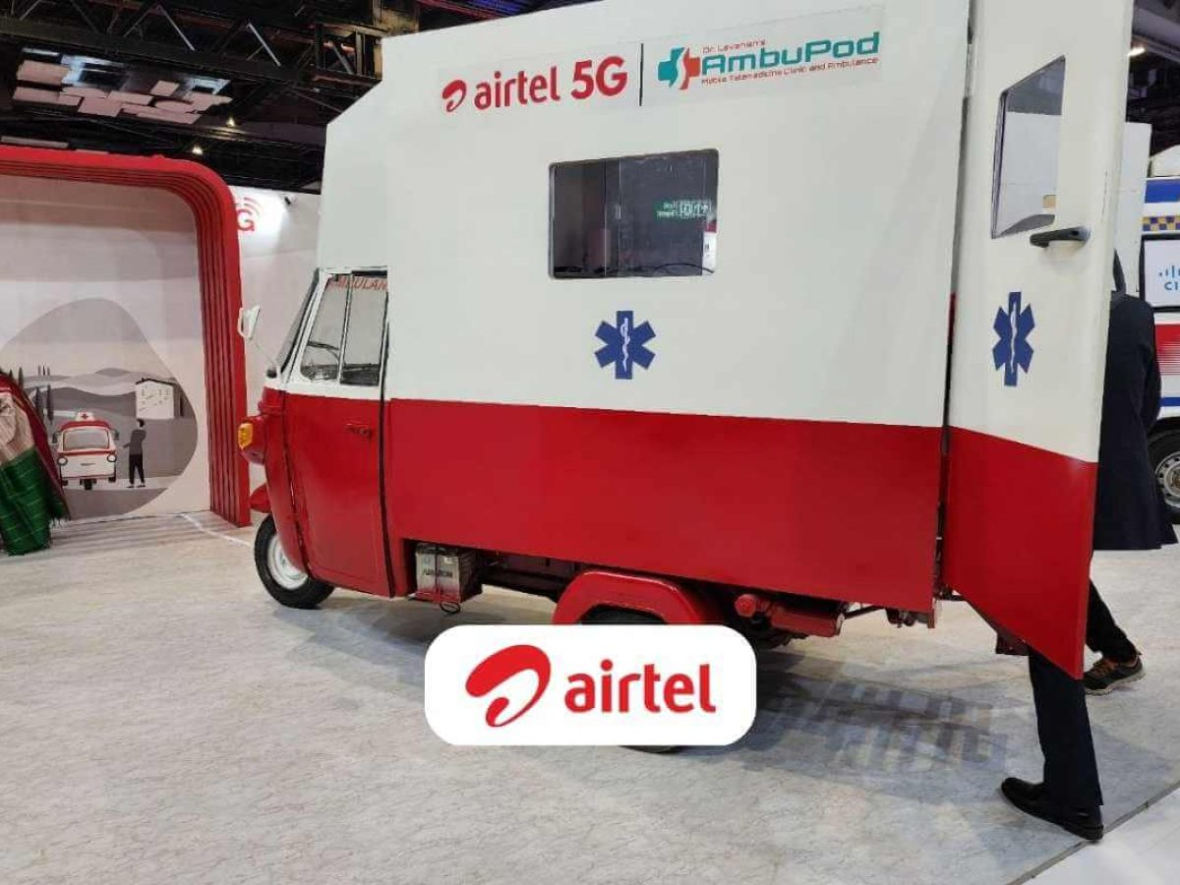

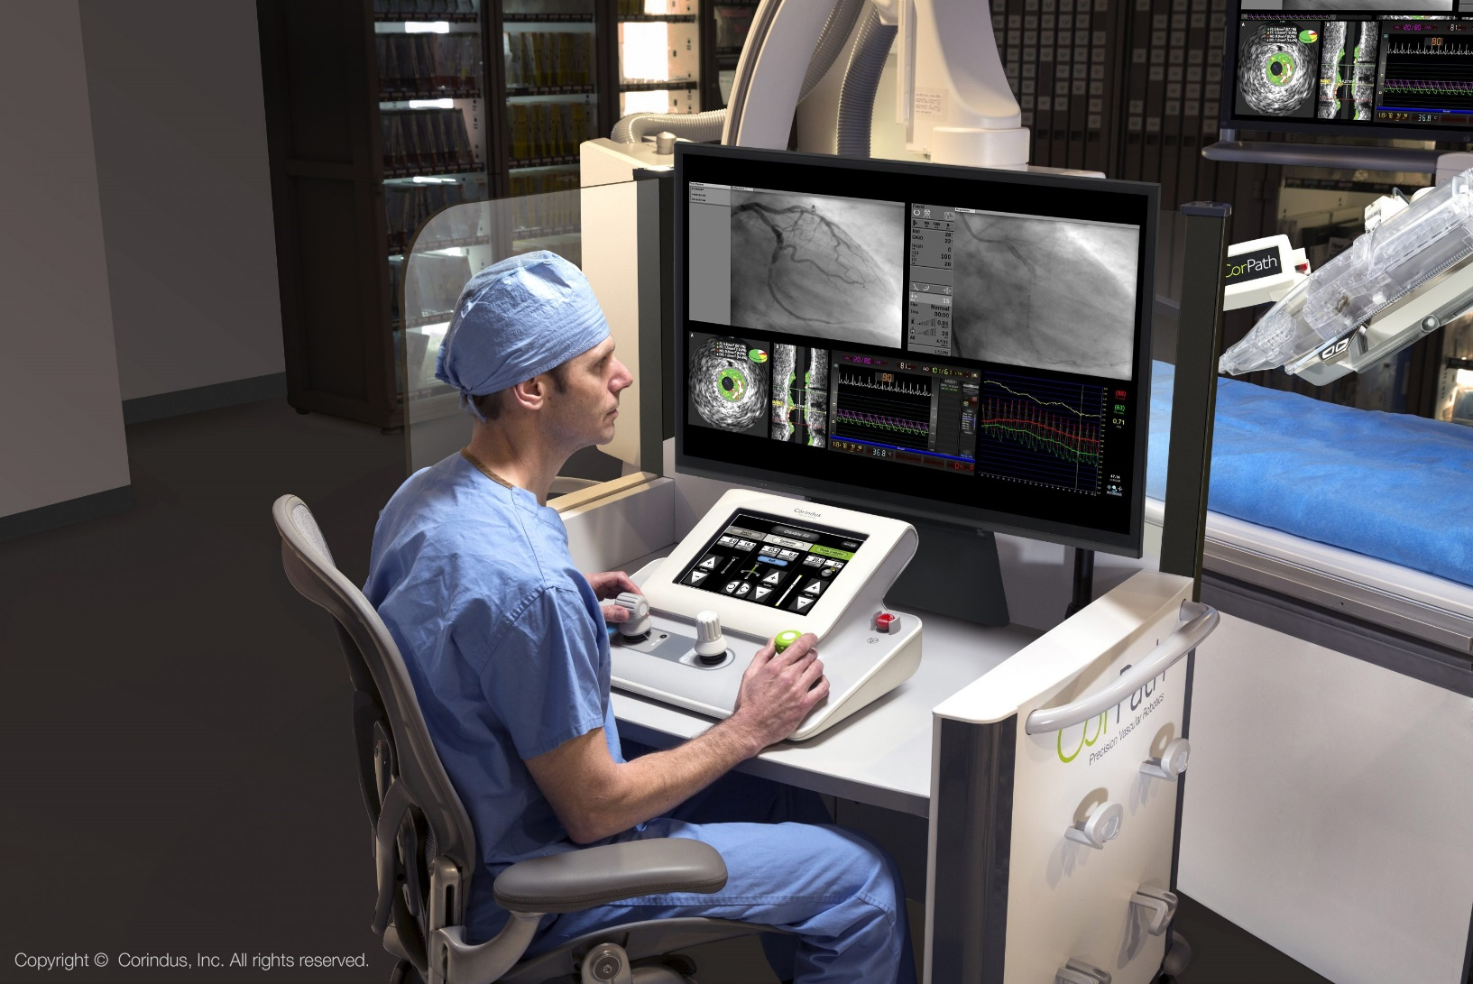

Fixed Wireless Access
Remote Surgery
VIRTUAL PRESENCE HEALTHCARE

Slide 11
Then. Why 6G?
Due to the rapid increase in Internet-of-Things (IoT) devices, next-generation communication systems aspire to achieve great spectrum and energy efficiency, low latency, and huge connection. These IoT gadgets will enable cutting-edge services like connected drones and robots that can transmit high definition (HD) and full HD video, smart traffic, environment monitoring and control, telemedicine, virtual reality (VR), and virtual navigation.
By 2025, there are expected to be 25 billion IoT devices, making it extremely difficult for the current multiple access strategies to handle such a large number of devices. Even the currently being pushed out fifth generation (5G) communication systems worldwide are unable to support such a large number of IoT devices. Project for a third-generation alliance

Slide 12


Shifting from Far-Field Beam Steering to
Near-field Beam Focusing

Slide 13
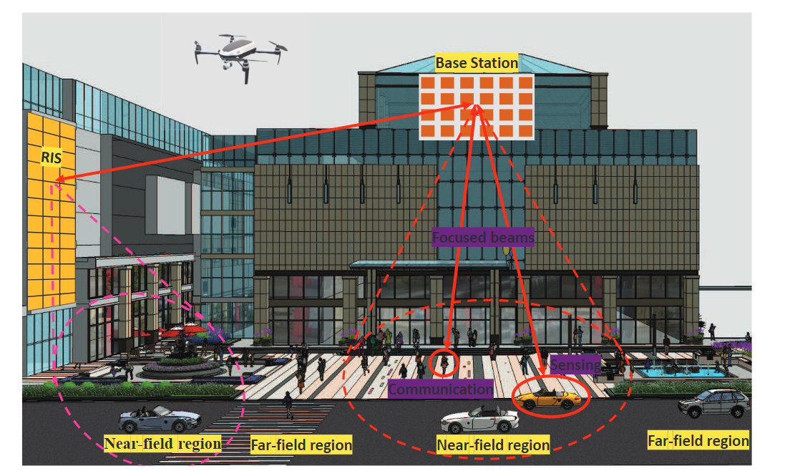
What is Far Field ? Near Field?
In communication, the "near field" is the region close to the transmitter or antenna, where electromagnetic waves have not yet fully propagated and exhibit strong variations. The "far field" is the region farther away, where waves have stabilized and behave predictably, making it suitable for long-range communication.

Slide 14
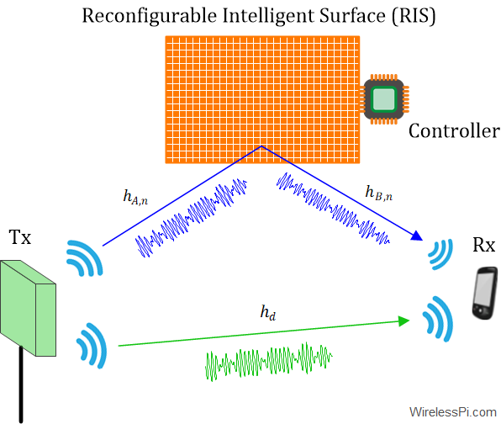
RIS
In communication, "RIS" stands for "Reconfigurable Intelligent Surface." RIS is a technology that uses a two-dimensional surface (typically made of passive elements like reflecting antennas or metamaterials) to manipulate and reconfigure electromagnetic waves.
RIS is used to improve wireless communication by optimizing signal propagation, reducing interference, and enhancing signal quality, particularly in environments with obstacles or signal degradation.
It has applications in 5G ,6Gand beyond for better signal coverage and capacity.

Slide 15
Far Field Vs Near Field Technology
discusses the critical characteristics of far-field and near-field communications for uplink and downlink scenarios.
A widely adopted metric to determine the boundary between far-field and near-field regions is the Rayleigh distance, also called the Fraunhofer distance.
When the communication distance between the BS and UE (BS-UE distance) is larger than the Rayleigh distance, the UE is located in the far-field region of the BS.
In far-field regions, the phase of EM waves can be elegantly approximated by a linear function of the antenna index through Taylor expansion.
Accordingly, by the utilization of planar wavefronts, far-field beamforming can steer the beam energy towards a specific angle over different distances, which is also termed as beamsteering.
The differences between far-field planar wavefronts and near-field spherical wavefronts bring several challenges and potentials to wireless communications, which will be detailed in the following sections.

Slide 16
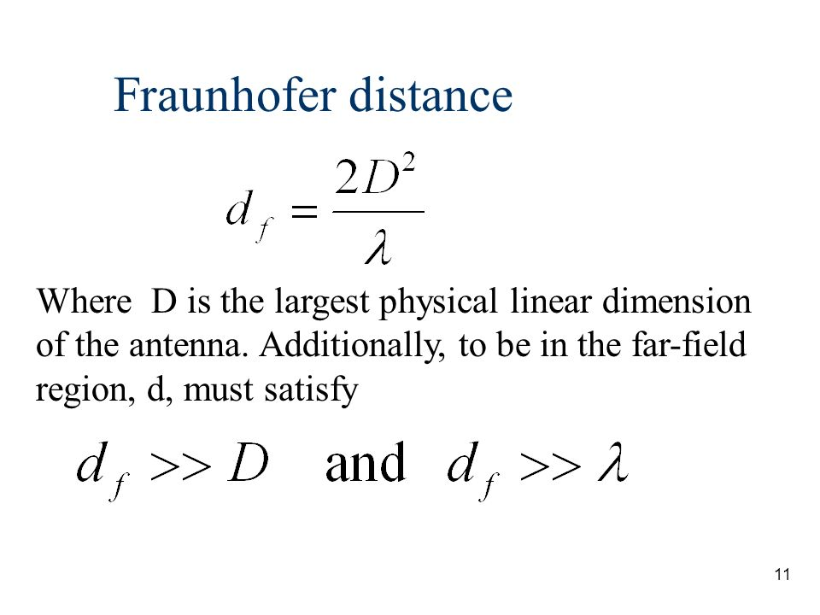
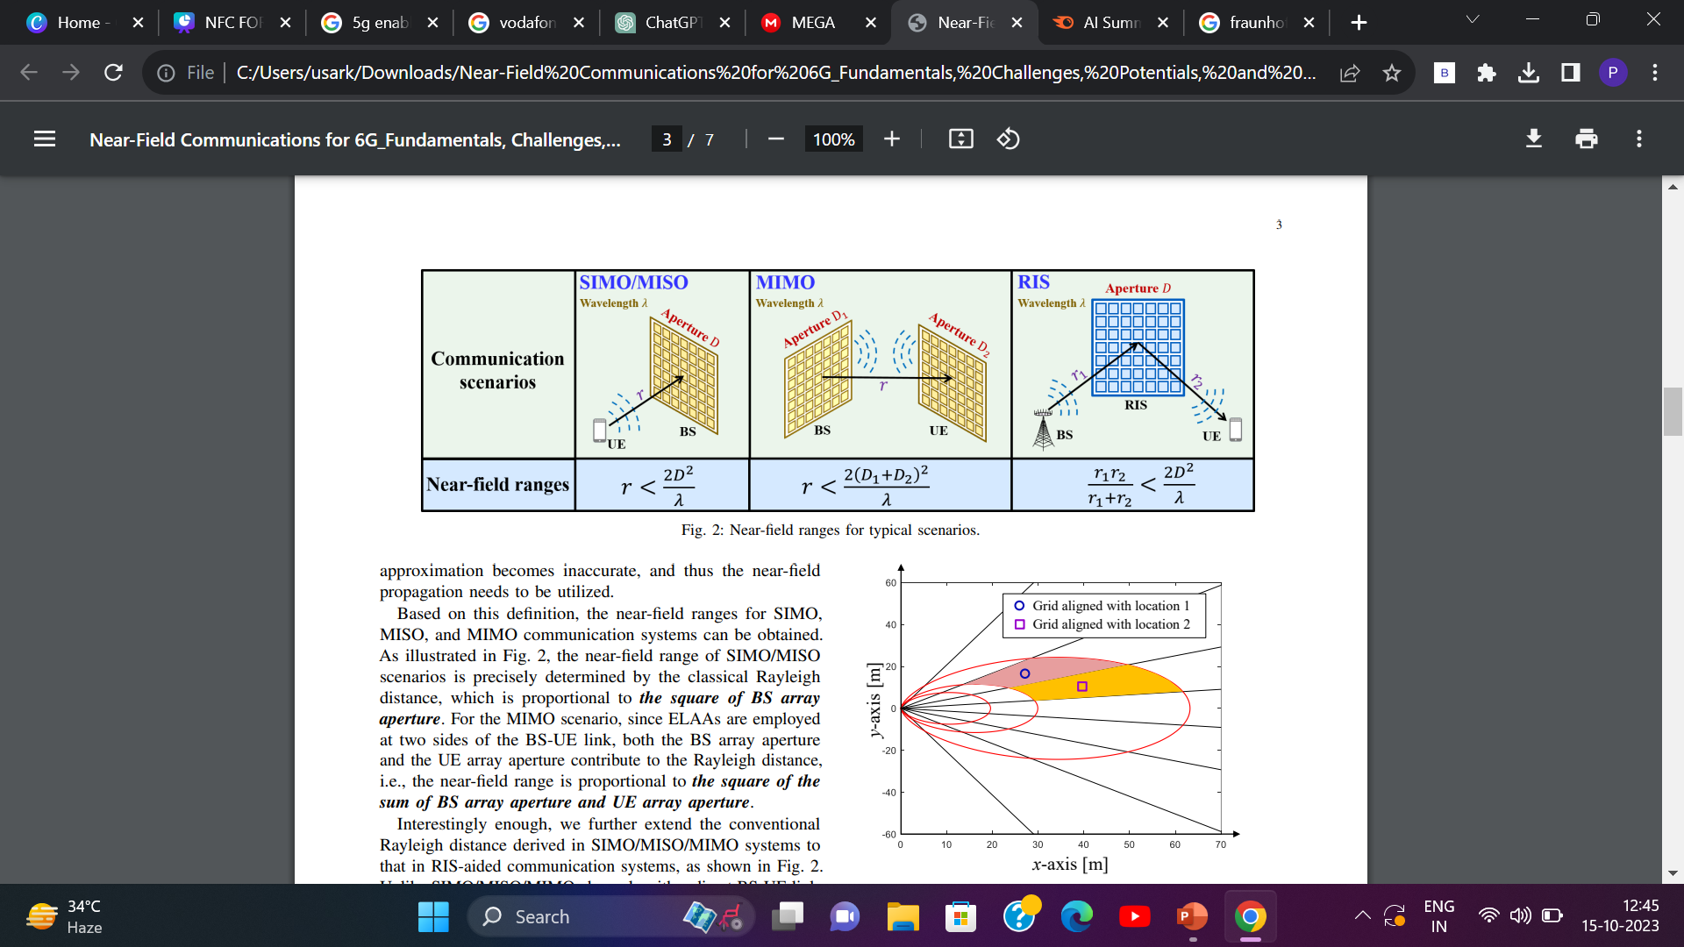




Rayleigh / Fraunhofer Distance
Near-field communications require accurate measurement of the boundary between far-field and near-field regions. The classical Rayleigh distance is proportional to the square of the array aperture and the inverse of the wavelength
Near-field ranges for SIMO, MISO, and MIMO communication systems can be obtained using this definition.
In RIS systems, the BS-RIS distance and the RIS-UE distance need to be added to capture the largest phase discrepancy. As long as any of these distances is shorter, RIS-aided communication is more likely to happen in RIS systems.

Slide 17


ELAA MIMO- part of NFC
extra-large array aperture multiple-input multiple-output (ELAA-MIMO) system installs large antenna arrays in building facades and other structures to provide more communication reliability, connectivity, and an increase in data rate transmission .
If it is employed in SIMO/MISO scenarios, its near-field range is about 25 meters. When both transmitter and receiver are equipped with this array, the nearfield range becomes 100 meters. Moreover, if this ELAA works as a RIS with a BS-RIS distance of 50 meters, the near-field propagation should be accepted once the RIS-UE distance is shorter than 50 meters. In summary, near-field communications come to be an indispensable part of future 6G.

Slide 18
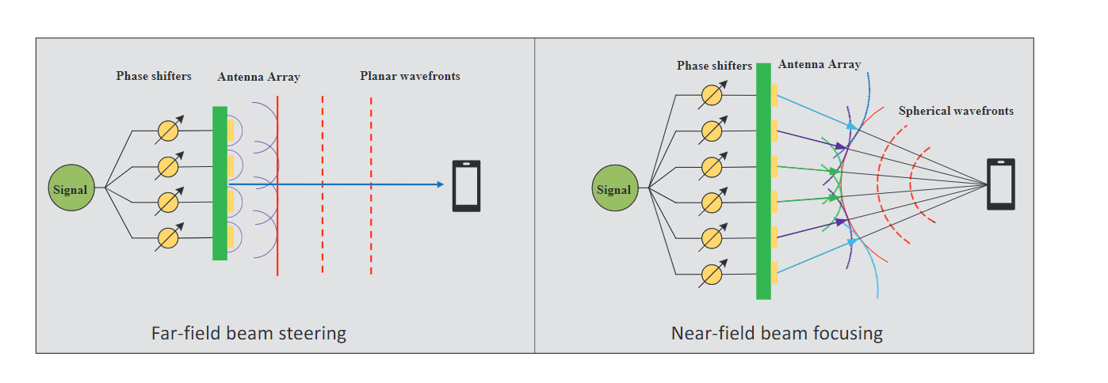
What is Far Field Beam Steering?
Far-field beam steering, also known as beamforming or phased array, is a technology used in various fields, including radar, telecommunications, and acoustics. It involves manipulating the direction of a beam of electromagnetic waves or sound waves, typically to enhance the performance of communication systems or sensors.

Slide 19
What is Near Field Beam Focusing?
Near field beam focusing, often referred to as near-field focusing, is a concept used in various fields, including optics, acoustics, and wireless communication. It involves the manipulation of waves, such as electromagnetic waves or acoustic waves, to concentrate them into a smaller spatial region or a "focus" within close proximity to the source. This is in contrast to traditional far-field beam propagation, where the waves propagate over long distances without significant focus.
Near field beam focusing is particularly useful in applications where you need to achieve high spatial resolution, enhance signal strength, or concentrate energy in a confined area.

Slide 20
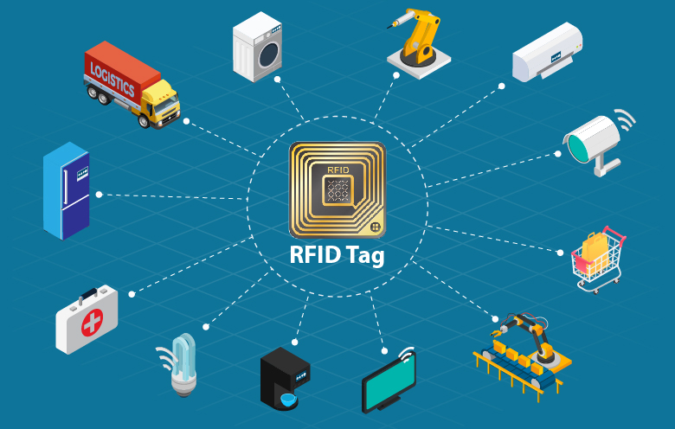
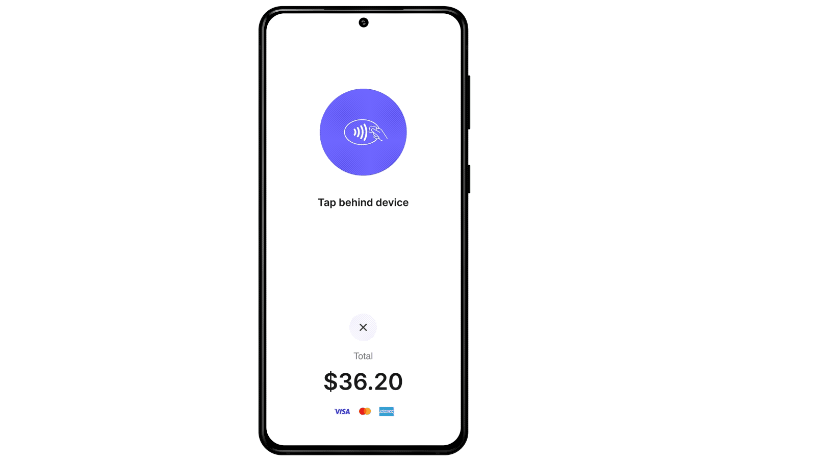
2 / 2
RFID (Radio-Frequency Identification) technology uses radio waves to identify, track, and manage objects, animals, or people. It consists of RFID tags with unique codes and RFID readers that communicate wirelessly. Commonly used in inventory management, access control, and contactless payment systems, it enables efficient data capture without direct line-of-sight contact.
Application of NFC
RFID Technology
RFID (Radio-Frequency Identification) technology uses radio waves to identify, track, and manage objects, animals, or people. It consists of RFID tags with unique codes and RFID readers that communicate wirelessly. Commonly used in inventory management, access control, and contactless payment systems, it enables efficient data capture without direct line-of-sight contact.
(RFID) refers to a wireless system comprised of two components: tags and readers. The reader is a device that has one or more antennas that emit radio waves and receive signals back from the RFID tag.

Slide 21


ML Application of NFC Based Payment Approvation

Slide 22

ML Application of NFC Based Payment Approvation

Slide 23
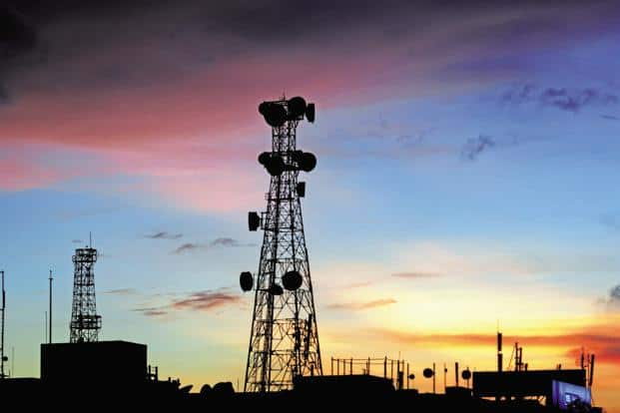

6G
CHALLENGES
& POTENTIALS

Slide 24

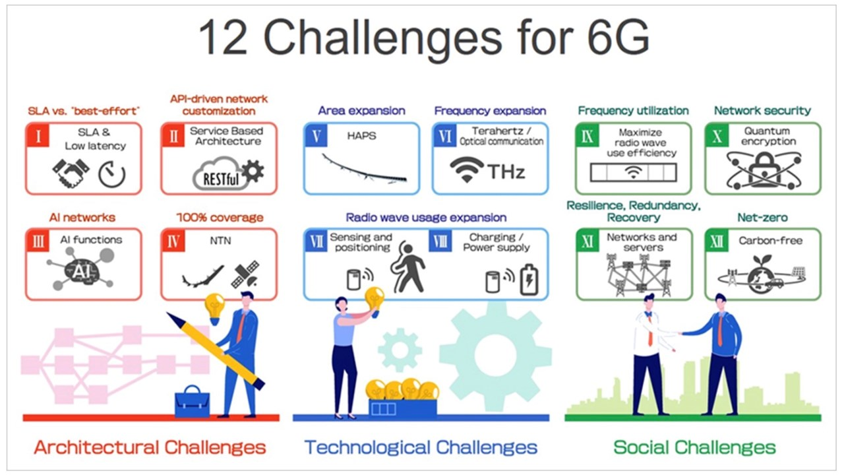


Slide 25
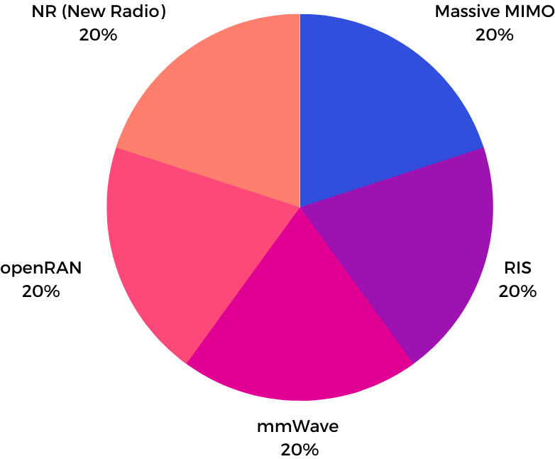
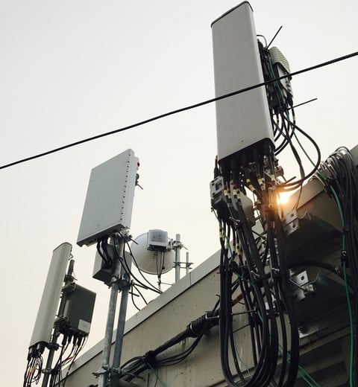


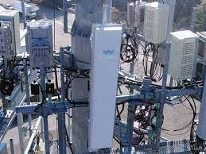

COMMUNICATION TECHNOLOGY & FURTHRE DEVELOPMENT
REAL LIFE DEPLOYMENT
Massive MIMO by BSNL
Open RAN by Airtel

Slide 26
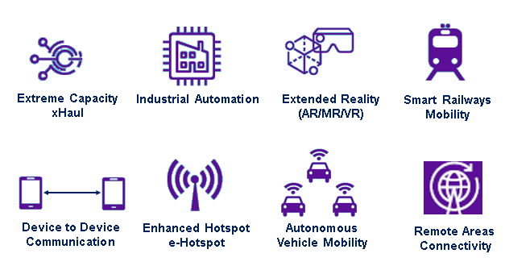
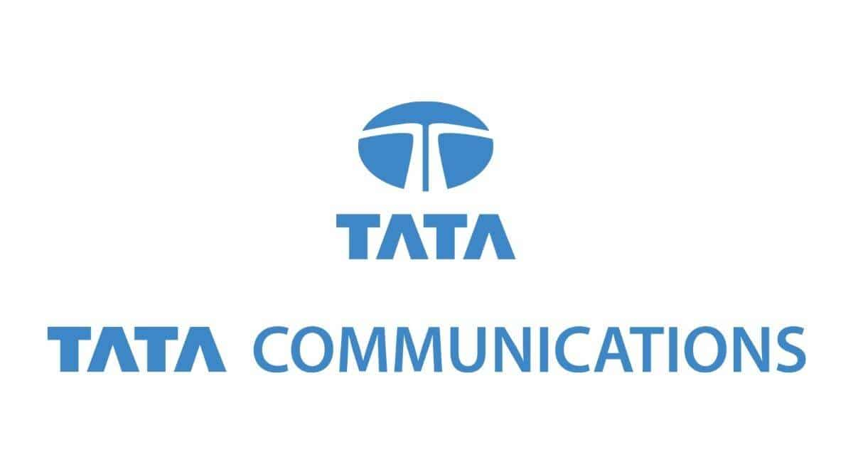

6G Potentials by Tata Communications 6G

Slide 27

Reference
SAMSUNG MOBILE NETWORKS
A review of Near Field Communication technology in several areas
Tata communication handbook

